Slide 1

Ad-hoc Business Insights Using SQL & Data Visualization with Power BI
Presented By :- Hitesh Sharma
11 March,2025

Slide 2
Introduction
About AtliQ Hardwares
AtliQ Hardwares is a leading electronics and consumer goods manufacturer, operating in multiple markets across Asia-Pacific.
The company specializes in producing and distributing high-quality hardware components, including electronic gadgets, computer accessories, and industrial hardware solutions.
AtliQ Hardwares is continuously expanding its market reach and sales channels through exclusive partnerships and e-commerce platforms. To support its growth, data-driven decision-making plays a crucial role in optimizing sales performance, supply chain efficiency, and customer insights.

Slide 3
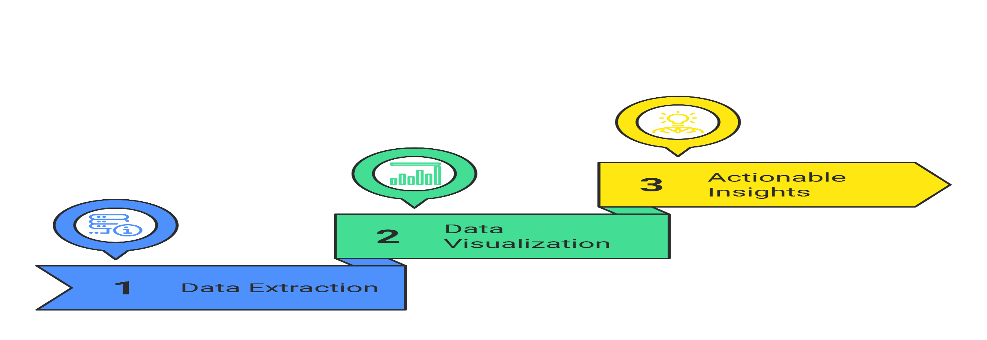
Project Overview
This project aims to analyze AtliQ Hardwares' sales, pricing trends, and customer demand using SQL for data extraction and Power BI for visualization. The goal is to derive actionable insights that help in making informed business decisions.

Slide 4
Dataset Details
The dataset includes six tables covering key aspects of sales, product pricing, and customer information:
dim_customer – Customer details (region, platform, channel)
dim_product – Product details (category, segment, variant)
fact_gross_price – Historical product pricing
fact_manufacturing_cost – Cost incurred in production
fact_pre_invoice_deductions – Discounts & deductions before invoicing
fact_sales_monthly – Monthly sales performance for each product

Slide 5
Tools Used
SQL – Data extraction, transformation, and business queries
Power BI – Data visualization and dashboard creation
Microsoft Excel / Google Sheets – Data exploration

Slide 6
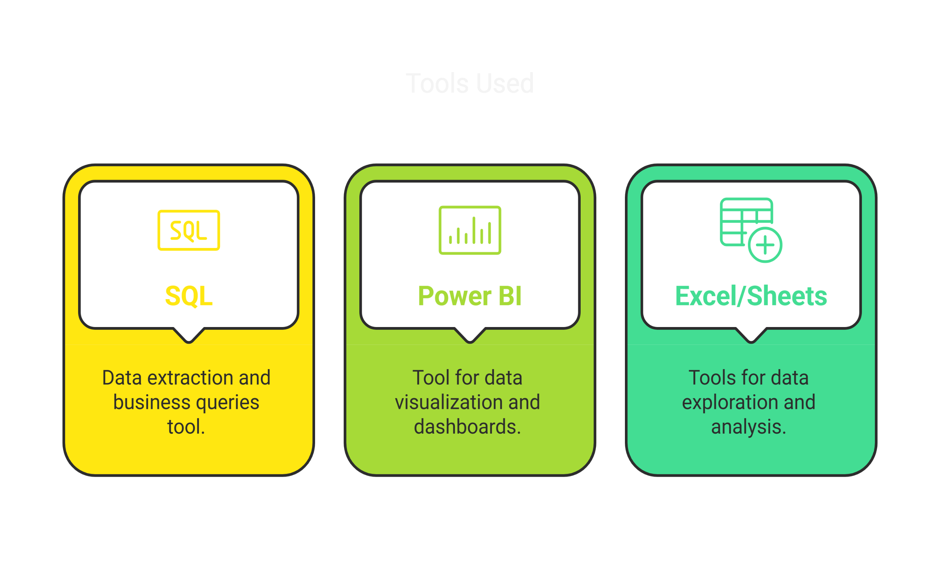

Slide 7
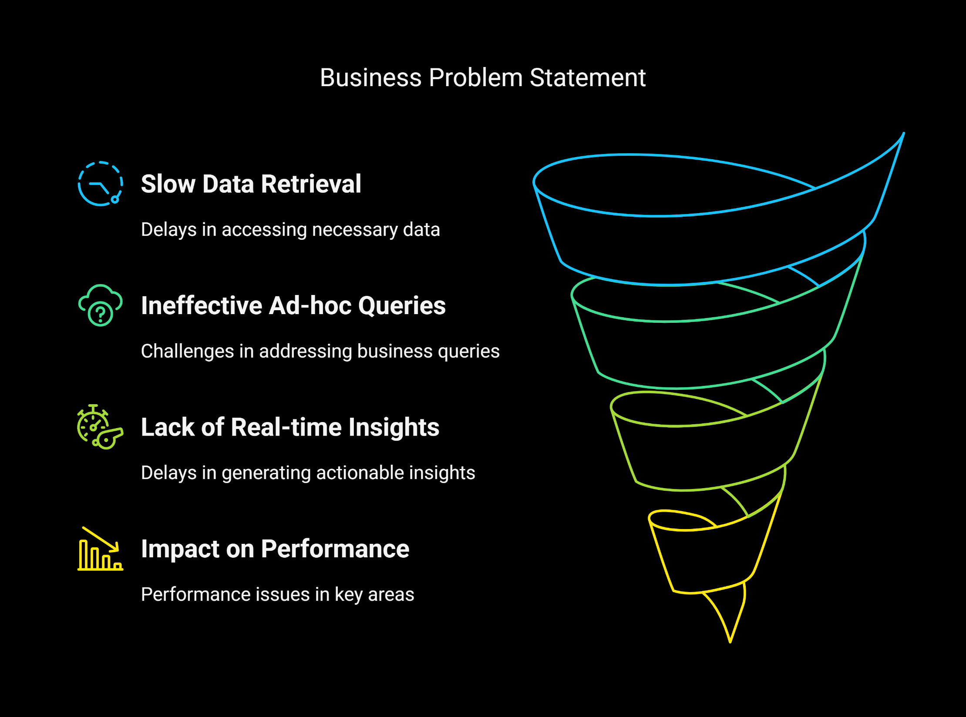

Slide 8
Ad-Hoc Business Requests & Insights

Slide 9
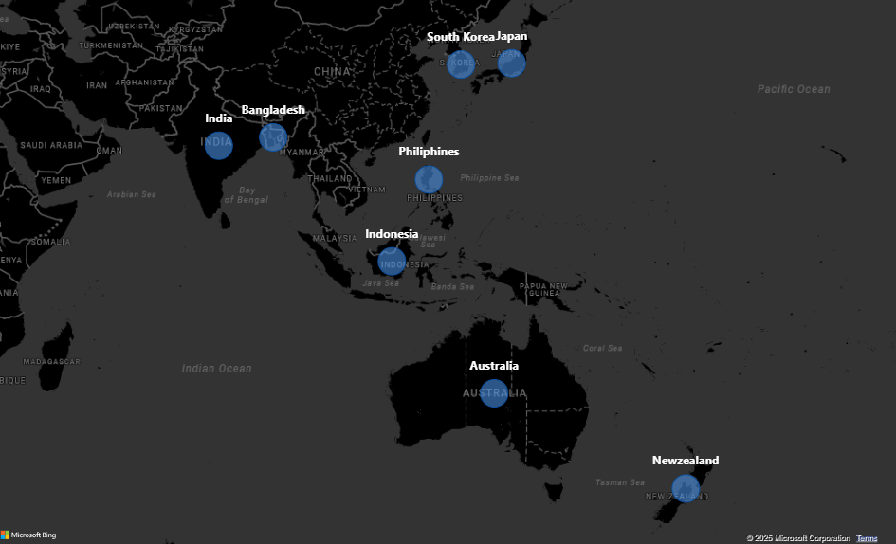
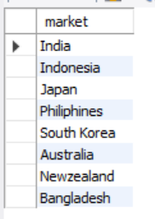
Q1. Provide the list of markets in which customer "Atliq Exclusive" operates its business in the APAC region ?
Business Insight :
AtliQ Exclusive has a strong presence in South Asia and the Asia-Pacific region, covering key markets like India, Indonesia, Japan, and Australia. This strategic placement allows for expansion opportunities in emerging markets such as Southeast Asia and neighboring regions.

Slide 10
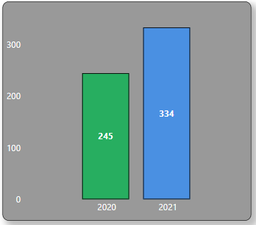

Q2. What is the percentage of unique product increase in 2021 vs. 2020 ?
Business Insight:
The number of unique products sold has significantly increased by 36.33% from 2020 to 2021. This suggests a strong product expansion strategy, indicating:
Diversification of the product portfolio to cater to evolving customer demands.
Increased market penetration, offering a wider variety of products to existing and new customers.
Potential revenue growth opportunities as more SKUs (Stock Keeping Units) are introduced in the market.

Slide 11
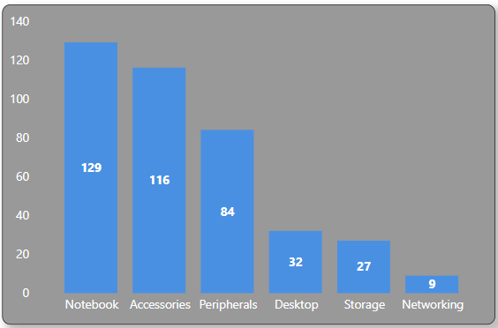
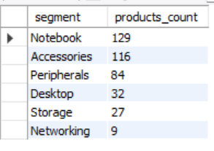
. Q3. Provide a report with all the unique product counts for each segment and sort them in descending order of product counts
Business Insight :
Notebook & Accessories are the leading segments, contributing the most product variety. This suggests strong market demand for portable computing solutions and add-ons.
Peripherals also hold a significant share, indicating a steady demand for external devices like keyboards, mice, and monitors.
Desktops & Storage segments have a lower number of unique products, potentially due to market shifts towards mobile computing and cloud-based storage solutions.
Networking products have the least variety, highlighting a possible underrepresentation in this category.

Slide 12
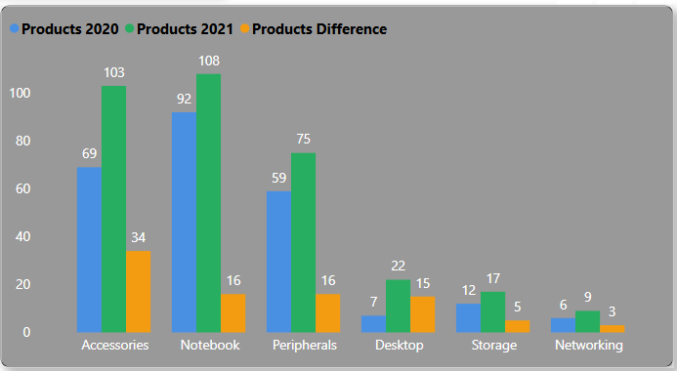
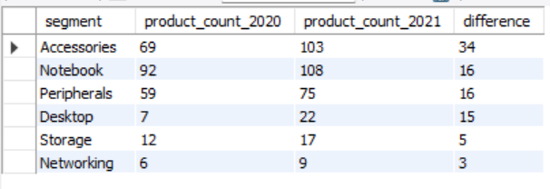
. Q4. Follow-up: Which segment had the most increase in unique products in 2021 vs 2020?
Business Insight :
Accessories saw the highest growth (+34 new products), indicating strong demand or a strategic expansion in this segment.
Notebook & Peripherals segments also showed consistent growth (+16 each), reflecting stable demand in computing and external device categories.
Desktop segment experienced a notable jump (+15 products), which could indicate a renewed interest in workstation solutions.
Storage & Networking segments saw minimal expansion, which may suggest lower priority or slower market adoption.

Slide 13
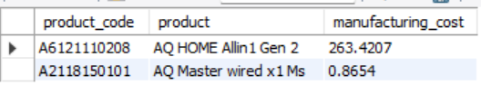
Q5. Get the products that have the highest and lowest manufacturing costs.
Business Insight :
The AQ HOME Allin1 Gen 2 has the highest manufacturing cost, likely due to advanced features, premium materials, or high production complexity.
The AQ Master Wired x1 Ms has the lowest manufacturing cost, which could indicate a mass-produced, cost - effective product.
Cost Optimization: If the high-cost product has low margins, explore supply chain efficiency or alternative components.
Profitability Check: Compare these manufacturing costs against selling prices to evaluate profitability.

Slide 14
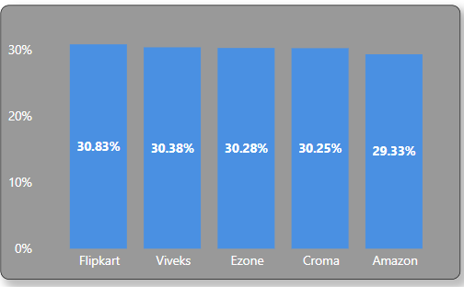
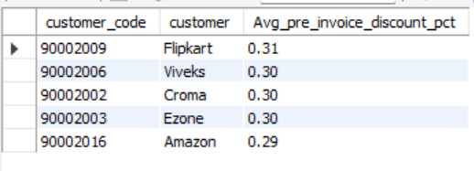
Q6. Generate a report which contains the top 5 customers who received an average high pre_invoice_discount_pct for the fiscal year 2021 and in the Indian market.
Business Insight :
Flipkart received the highest average pre-invoice discount (31%), followed by Viveks, Croma, Ezone (30%) and Amazon (29%).
Online vs Offline Retailers:
Flipkart & Amazon (E-commerce platforms) receive the highest discounts, likely due to bulk purchasing, long-term partnerships, or competitive pricing agreements.
Viveks, Croma, and Ezone (Electronics retailers) also receive high discounts, indicating strong supplier relationships.

Slide 15
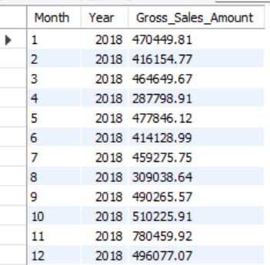
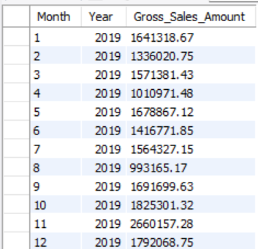
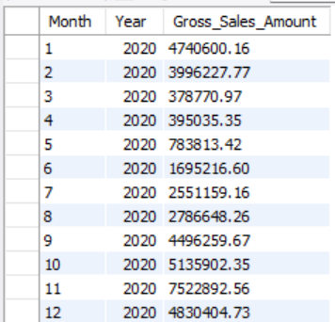
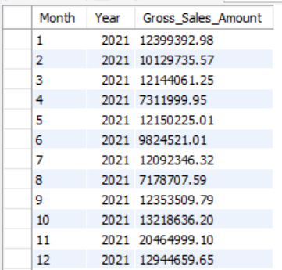
Q7. Get the complete report of the Gross sales amount for the customer “Atliq Exclusive” for each month. This analysis helps to get an idea of low and high-performing months and take strategic decisions.

Slide 16
Business Insight :
FY2017-2018
Available Data: Jan-Aug 2018 only
Sales Range: $287K-$477K monthly
Strongest Month: May ($477K)
Consistent Performance: Most months between $400K-$470K
FY2018-2019
Complete Cycle: Sep 2018-Aug 2019
Key Insight: Strong Q2 performance (Nov-Jan)
Peak Month: November ($780K)
Year-End Performance: Consistently above $1M in final months
FY2019-2020
Growth Trend: First half shows steady growth
Disruption Point: March 2020 saw dramatic drop ($378K)
Recovery Signs: Gradual improvement in last quarter
Critical Observation: COVID impact clearly visible in Q4
FY2020-2021
Transformation Year: Recovery to unprecedented growth
Sales Range: $2.5M-$12.1M
Q3-Q4 : Exceptional growth with all months exceeding $7M
Strategic Value: Demonstrated resilience and ability to scale
FY2021-2022
Remarkable Scale: All months above $12M
Peak Performance: November 2021 ($20.4M)
End-of-Year Momentum: Strong finish to the financial year
FY2022-2023 (Partial)
Limited Data: Only Sep-Dec 2022
Explosive Growth: Monthly sales $57M-$95M
November Effect: Consistent peak at $95.7M, maintaining the pattern
Scale Transformation: 5-year CAGR of approximately 230%

Slide 17
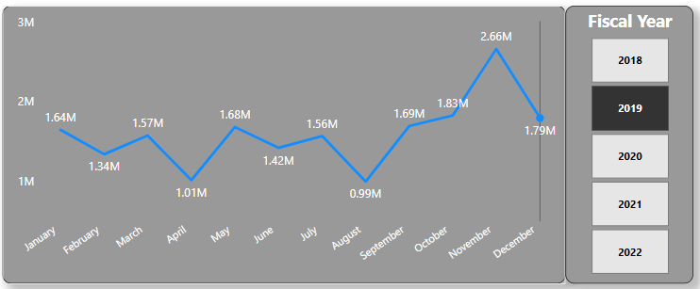
In this visualization, I have implemented a fiscal year slicer instead of creating separate visuals for each year. This allows for an interactive analysis of gross sales trends across different years in a single view, enhancing comparability and efficiency in decision-making.
Key Business Insights (Financial Year Perspective):
Q2 Strength: November (3rd month of FY) consistently delivers peak performance
First-Half Dominance: Sep-Feb typically stronger than Mar-Aug
Financial Planning: Budget for marketing and inventory should align with Q2 peak season
Growth Pattern: Each financial year starts stronger than previous ended
Pandemic Recovery: FY2020-21 demonstrates remarkable organizational resilience

Slide 18
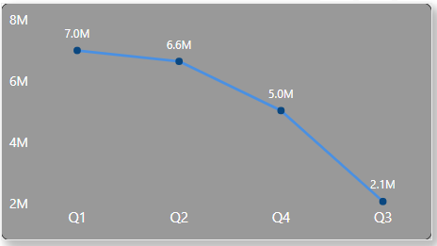
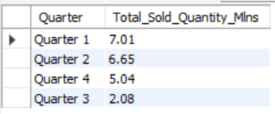
Q8. In which quarter of 2020, got the maximum total_sold_quantity?
Business Insight :
Strong Start: Q1 saw the highest sales, possibly due to seasonal demand, product launches, or promotional campaigns.
Gradual Decline: Sales steadily declined across the following quarters, with a sharp drop in Q3 (2.1M units), indicating potential supply chain disruptions, reduced market demand, or increased competition.
Strategic Focus: To sustain high sales throughout the year, strategies like inventory planning, demand forecasting, and targeted promotions should be explored.

Slide 19
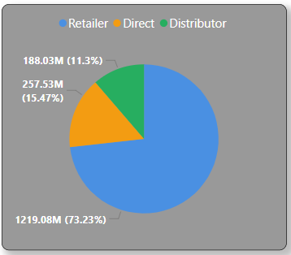
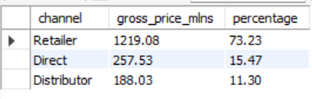
Q9. Which channel helped to bring more gross sales in the fiscal year 2021 and the percentage of contribution?
Business Insight :
Dominant Sales Channel: Retailers played a crucial role in revenue generation, making up
the majority of sales.
Direct & Distributor Share: The Direct channel contributed 15.47%, while Distributors accounted for 11.30%, indicating potential growth opportunities.
Strategic Focus: To maintain and enhance sales, optimizing retailer relationships while expanding Direct and Distributor channels can help diversify revenue streams and reduce dependency on a single channel.

Slide 20
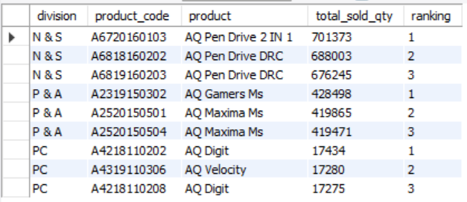
Q10. Get the Top 3 products in each division that have a high total_sold_quantity in the fiscal_year 2021?
Business Insight :
High Demand Products: Pen Drives are the best-selling products under the N & S division, indicating high customer demand for portable storage devices.
Peripherals Drive Sales: The P & A division saw notable demand for gaming accessories and computer peripherals.
Low Sales in PC Division: The PC division has significantly lower sales volumes, possibly due to declining desktop demand.

Slide 21
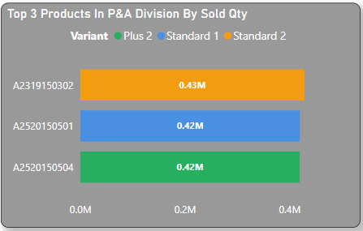
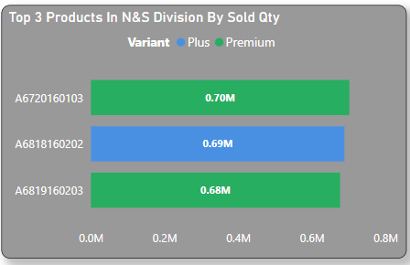
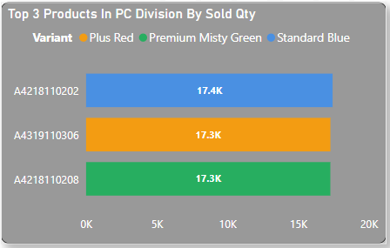

Slide 22
Business Recommendations For AtliQ Hardwares

Slide 23
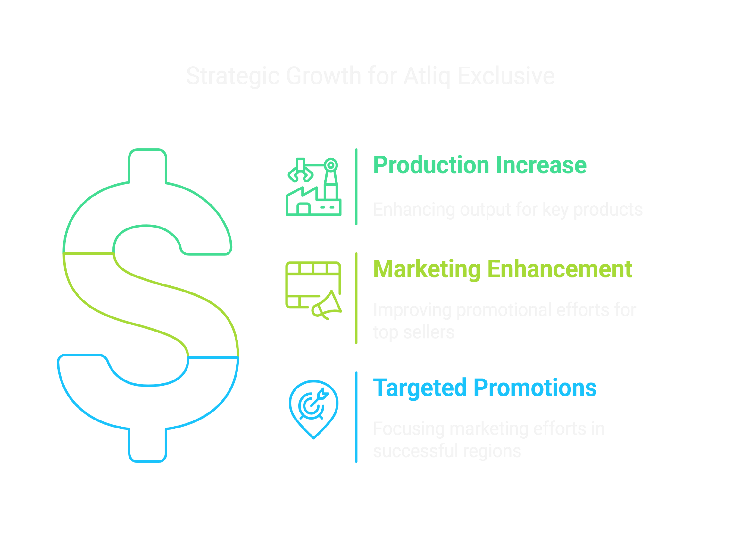

Slide 24
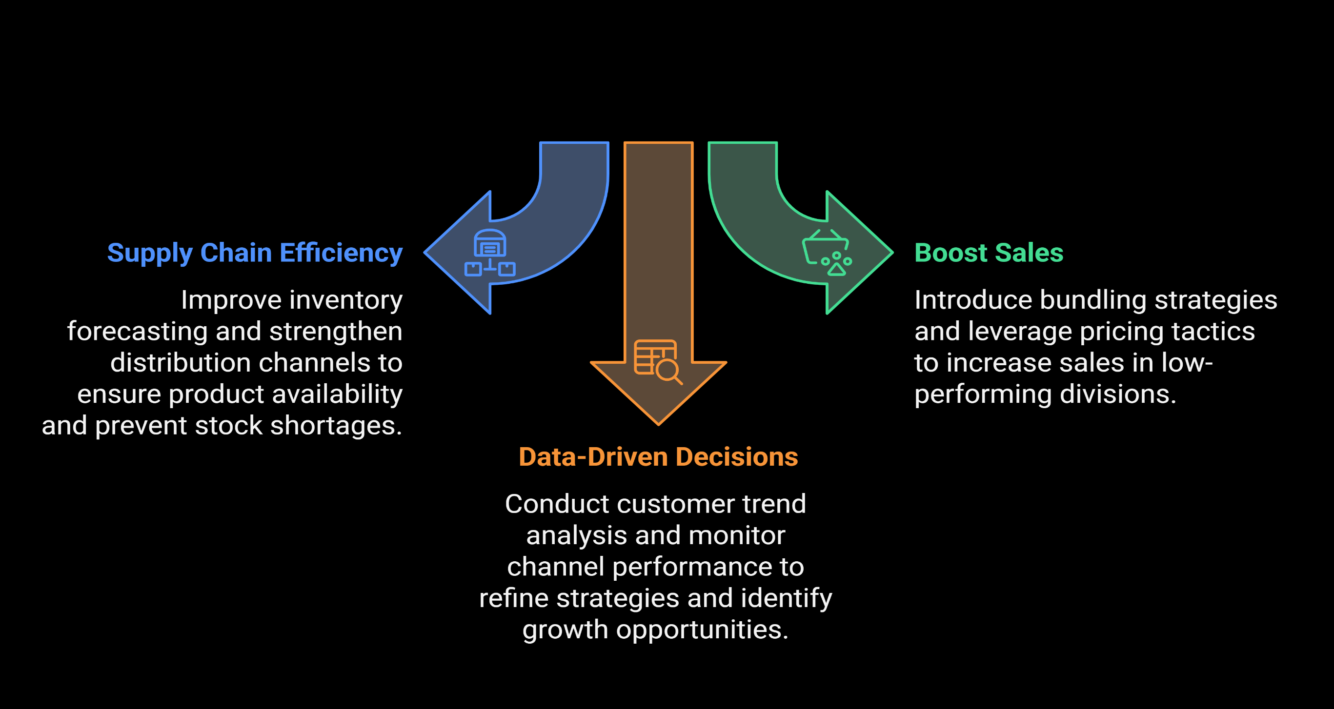

Slide 25


Thank You!
I appreciate your time and attention.
Looking forward to your feedback and discussions.
Let's collaborate to drive data-driven success.
hiteshere18
Data speaks, and we listen --- together, we grow

